Slide 1
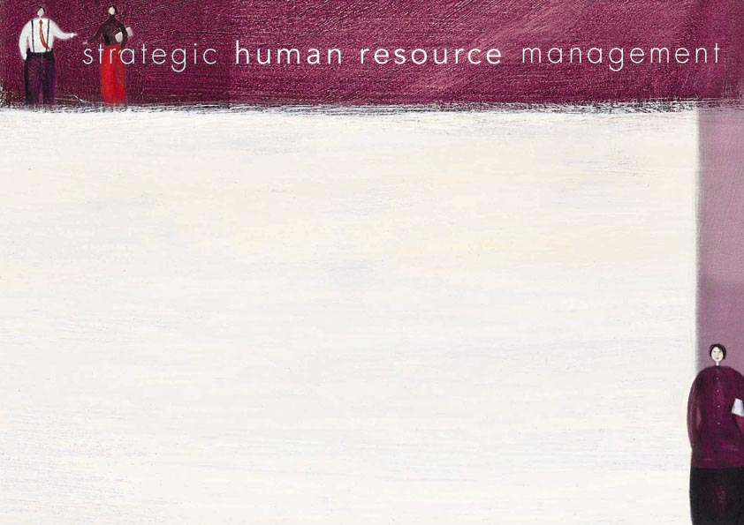
CHAPTER 2
Organisational strategy, structure, culture and policy

Slide 2
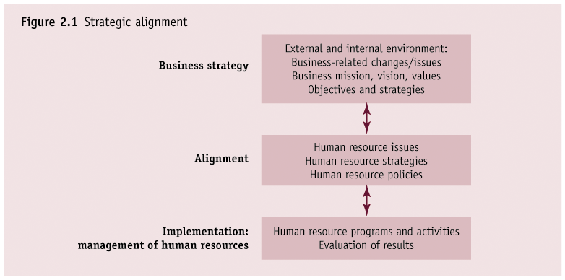

Slide 3
SHRM and business strategy
HR and organisational strategy linkages:( SHRM is a fit between business and HRM strategies)
Accommodative ( HR strategies simply following organizational strategies accommodating the staff needs of already chosen business strategies)
Interactive ( A two way communication process between HRM and corporate planning in which HRM contributes or react to overall strategy)
Fully integrated ( HR specialist is involved in the overall strategic process both formal and informal interaction ; a real reflection of SHRM practices).

Slide 4
Critics of SHRM
Can SHRM adopt a flexible and strategic perspective?
Can practitioners implement the SHRM agenda?

Slide 5
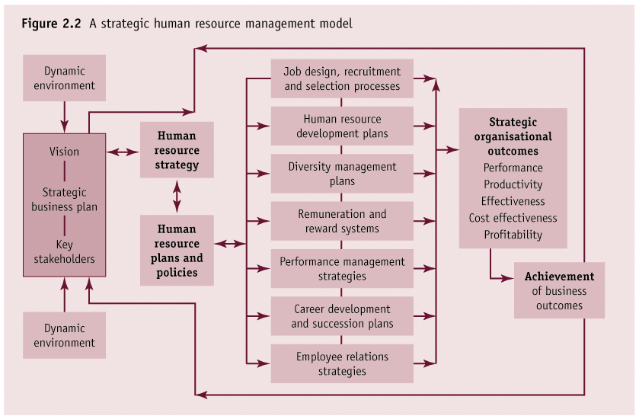

Slide 6
SHRM – strategy, structure, culture and policy
Relationships:
Culture
Strategy
Structure

Slide 7
Organisational culture and HRM
Organisational culture includes philosophies, values, beliefs, work systems and practices, expectations and limitations on employee behaviour
Four broad types:
Elite
Meritocratic
Collegial
Leader-focused

Slide 8
Cultural change
Excellence theorists believe that culture can be modified to achieve efficiency/profitability
Structural efficiency principle (SEP) and Award restructuring put pressure on organisations to change work practices and modify traditional cultures
HR specialist drives the process
Change can also result from innovative HR approaches

Slide 9
Principles of effective HR policies
Congruency
Compatibility
Clarity
Stability
Flexibility
Cultural appropriateness
Relationships

Slide 10
HRM structures
No HR function
Line managers alone
Line managers, with centralised HR support
Centralised functional generalists
Centralised functional specialists
Decentralised functional generalists or specialists
Contract specialists

Slide 11
Strategic partnerships
The new HR
Devolvement of HRM functions
Joint provision of HR services
Strategic focus of role

